Slide 1
Signal encoding techniques
Chapter 5, William Stallings

Slide 2
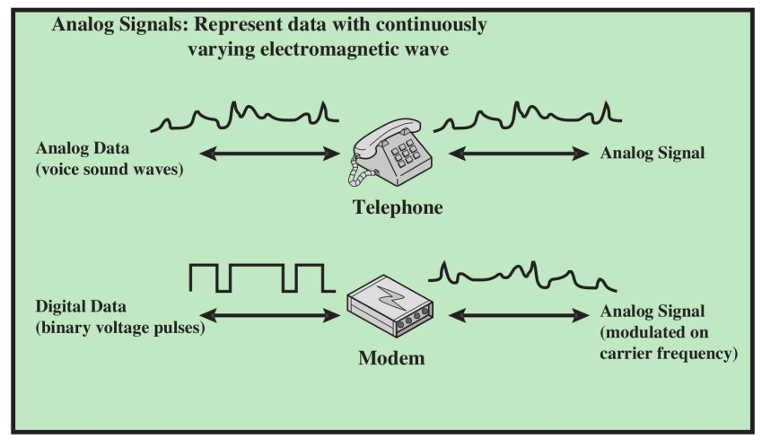
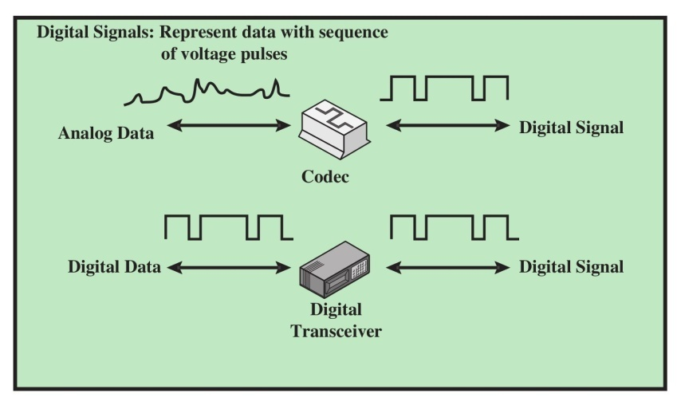
Both analog and digital information can be encoded as either analog or digital signals.
Analog Signaling of Analog and Digital Data
Digital Signaling of Analog and Digital Data
.

Slide 3
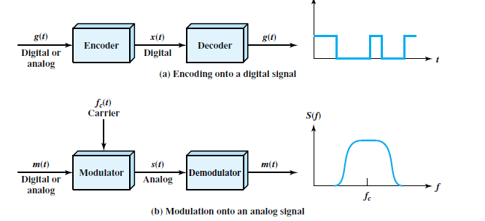

Encoding and Modulation Techniques
x(t) depends on the encoding technique and is chosen to optimize use of the transmission medium.

Slide 4
The basis for analog signaling is a continuous constant-frequency signal known as the carrier signal.
Data may be transmitted using a carrier signal by modulation.
Modulation is the process of encoding source data onto a carrier signal with frequency. All modulation techniques involve operation on one or more of the three fundamental frequency domain parameters: amplitude, frequency, and phase.
The input signal m(t) may be analog or digital and is called the modulating signal or baseband signal.
The result of modulating the carrier signal is called the modulated signal s(t).

Slide 5
Digital Data, Digital Signals
A digital signal is a sequence of discrete, discontinuous voltage pulses.
Each pulse is a signal element.
Binary data are transmitted by encoding each data bit into signal elements.
In the simplest case, there is a one-to-one correspondence between bits and signal elements.

Slide 6
Linecoding is the process of converting digital data to digital signals. By below mentioned techniques we can convert a sequence of bits to a digital signal.
At the sender side digital data are encoded into a digital signal and at the receiver side the digital data are recreated by decoding the digital signal.
We can roughly divide line coding schemes into five categories:
  1.Unipolar(eg.NRZ scheme).
  2.Polar(eg. NRZ-L,NRZ-I, RZ, and Biphase–Manchester and differential Manchester).
  3.Bipolar(eg. AMI and Pseudoternary).
  4.Multilevel
  5.Multitransition

Slide 7

r : The number of data elements carried by each signal element.

Slide 8
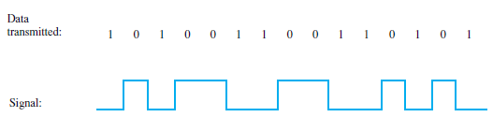
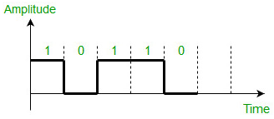
Key terms
Unipolar signaling schemes, positive voltage defines bit 1 and the zero voltage defines bit 0. (either all positive or all negative).

Slide 9
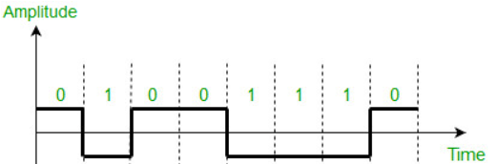
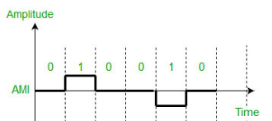

Polar signaling schemes, one logic state is represented by a positive voltage level, and the other by a negative voltage level
Bipolar signaling schemes– In this scheme there are three voltage levels positive, negative, and zero.

Slide 10
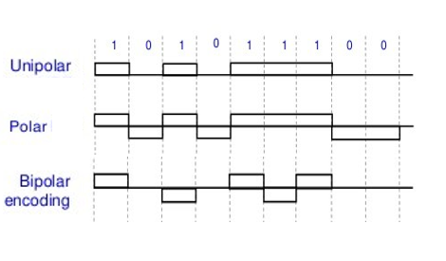
Unipolar, Polar and Bipolar schemes

Slide 11
At the transmitter:
The data signaling rate, or just data rate, of a signal is the rate, in bits per second, that data are transmitted.
The duration or length of a bit is the amount of time it takes for the transmitter to emit the bit; for a data rate R, the bit duration is 1/R.
The modulation rate(baud- signal elements per second), in contrast, is the rate at which the signal level is changed. This will depend on the nature of the digital encoding.

Slide 12
At the receiver:
It must know the timing of each bit. That is, the receiver must know with some accuracy when a bit begins and ends.
It must determine whether the signal level for each bit position is high (0) or low (1).

Slide 13
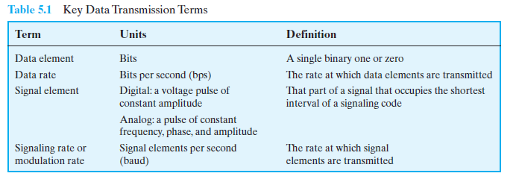

Slide 14
The ways of evaluating or comparing the various techniques
Signal spectrum:
Clocking:
Error detection:
Signal interference and noise immunity:
Cost and complexity:

Slide 15
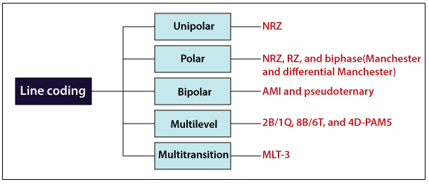

Slide 16
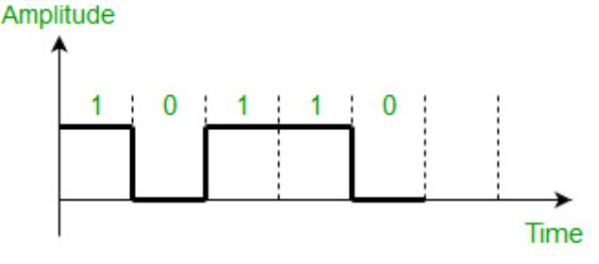
Non return to zero (NRZ)
NRZ - the signal does not return to zero at the middle of the bit. Positive voltage defines bit 1 and the zero voltage defines bit 0

Slide 17
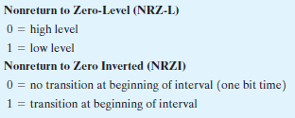
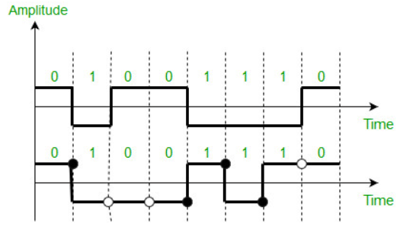

Slide 18
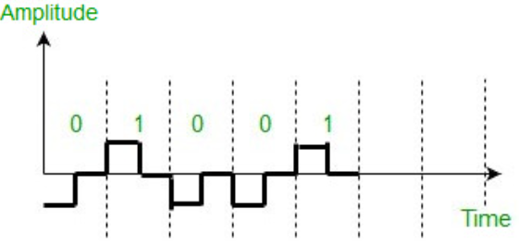
Return to zero (RZ)- uses three values positive, negative, and zero. In this scheme signal goes to 0 in the middle of each bit.

Slide 19
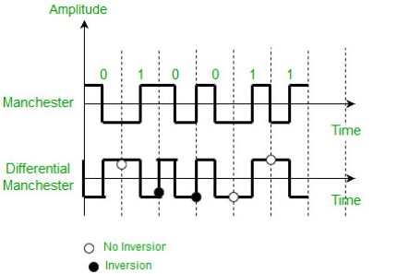
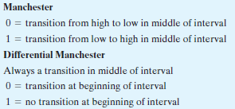

Slide 20
Overcomes the limitations of NRZ codes.(Expected transition).
Midbit transition is for synchronization
  Manchester: For data and clocking
  Differential Manchester: Only for clocking
Bandwidth utilization is more: Two transition per bit time.
No dc component
Error detection : Expected transition does not occur.

Slide 21
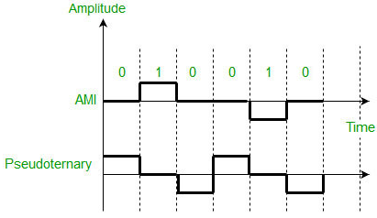
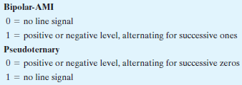
Alternate Mark Inversion (AMI) – A neutral zero voltage represents binary 0. Binary 1’s are represented by alternating positive and negative voltages.
Pseudoternary – Bit 1 is encoded as a zero voltage and the bit 0 is encoded as alternating positive and negative voltages i.e., opposite of AMI scheme. Example: Data=010010.

Slide 22
Bipolar AMI :
  No synchronization problem for long 1’s but for 0’s still exist.
  Bandwidth utilization is less over NRZ.
  No dc component(alternate positive and negative voltage).
  Error detection (pulse alteration does not happen).
  Adding or removing pulse can be an undetected error.
Pseudoternary:
  No synchronization problem for long 0’s but for 1’s still exist.

Slide 23
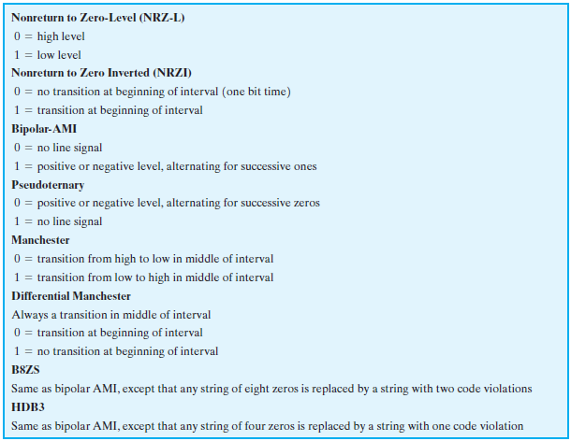
Digital data to digital signal

Slide 24
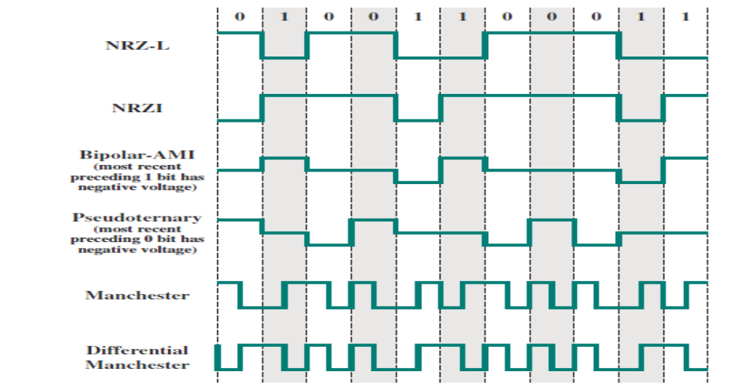

Slide 25
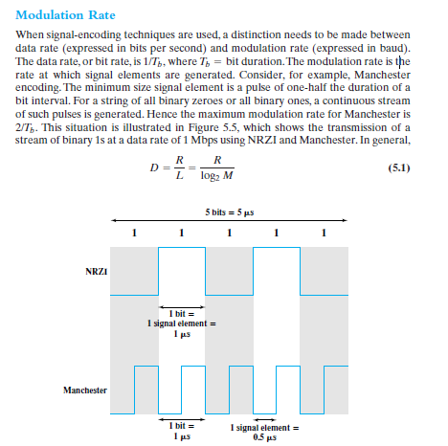

Slide 26
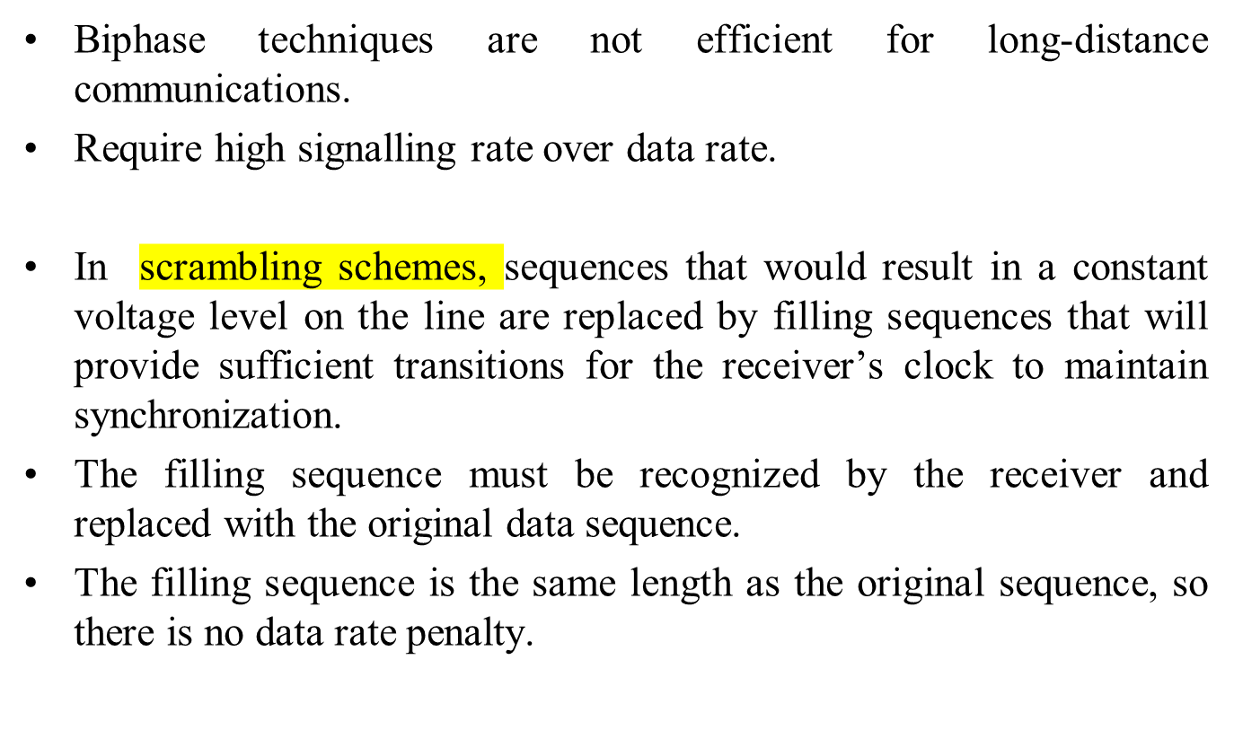
Scrambling Techniques

Slide 27
The design goals for this approach can be summarized as follows:
• No dc component
• No long sequences of zero-level line signal
• No reduction in data rate
• Error-detection capability

Slide 28
HDB3
High Density Bipolar 3 Zeros
Based on bipolar-AMI
String of four zeros replaced with one or two pulses

Slide 29
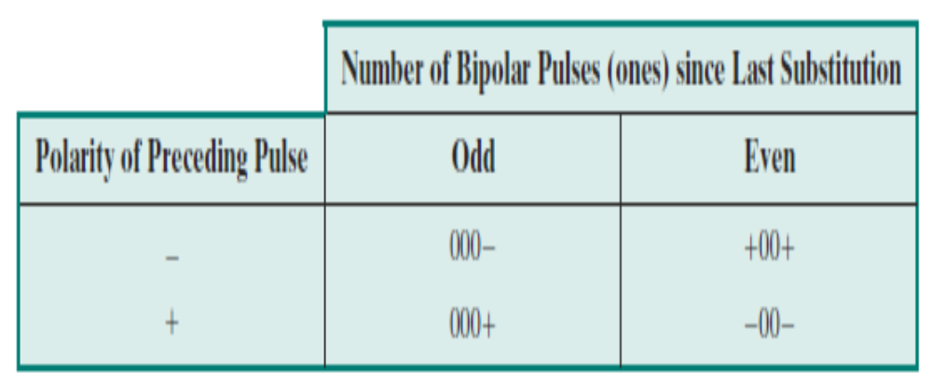
HDB3 Rules

Slide 30
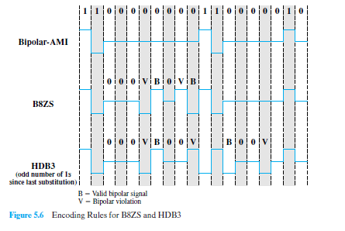


Slide 31
Digital data, Analog signals

Slide 32
DIGITAL DATA, ANALOG SIGNALS
Digital information changes the carrier signal by modifying one or more of its characteristics (amplitude, frequency, or phase).
Modulation techniques :
Amplitude shift keying (ASK)
Frequency shift keying (FSK)
Phase shift keying (PSK)
Quadrature Amplitude Modulation (QAM)
.

Slide 33

Amplitude Shift Keying
In ASK, the two binary values are represented by two different amplitudes of the carrier frequency.
One of the amplitudes is zero; that is, one binary digit is represented by the presence, at constant amplitude, of the carrier, the other by the absence of the carrier.
Susceptible to sudden gain changes, so inefficient.

Slide 34
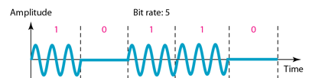

Binary amplitude shift keying
Binary amplitude shift keying

Slide 35
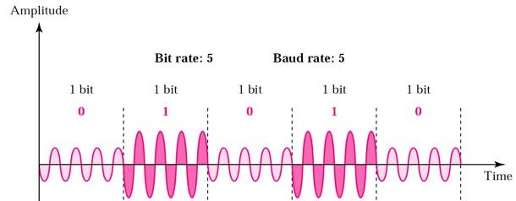
Binary amplitude shift keying

Slide 36

Implementation of binary ASK

Slide 37
Example
Given a bandwidth of 10,000 Hz (1000 to 11,000 Hz), draw the full-duplex ASK diagram of the system. Find the carriers and the bandwidths in each direction. Assume there is no gap between the bands in the two directions.

Slide 38
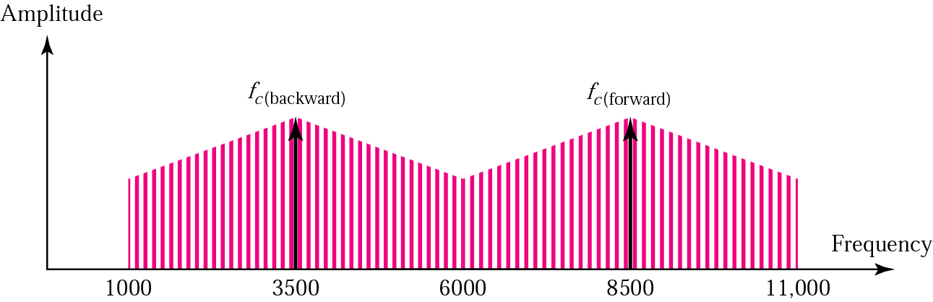
For full-duplex ASK, the bandwidth for each direction is
BW = 10000 / 2 = 5000 Hz
The carrier frequencies can be chosen at the middle of each band
fc (backward) = 1000 + 5000/2 = 3500 Hz
fc (forward) = 11000 – 5000/2 = 8500 Hz

Slide 39
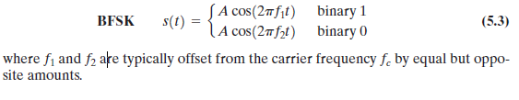
Binary frequency shift keying
Two binary values are represented by two different frequencies near the carrier frequency.

Slide 40
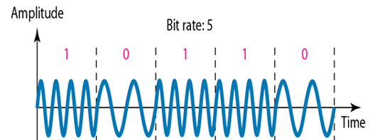
Binary frequency shift keying

Slide 41
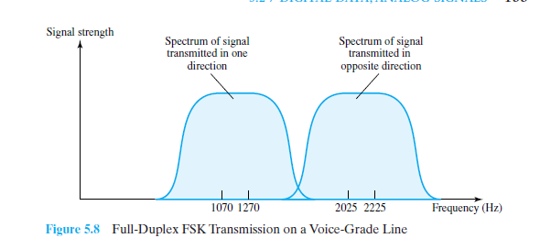
To achieve full-duplex transmission, this bandwidth is split.
In one direction (transmit or receive), the frequencies used to represent 1 and0 are centered on 1170 Hz, with a shift of 100 Hz on either side.
The effect of alternating between those two frequencies is to produce a signal whose spectrum is indicated as the shaded area

Slide 42
BFSK is less susceptible to error than ASK.
On voice-grade lines, it is typically used up to 1200 bps.
It is also commonly used for high-frequency (3 to 30 MHz) radio transmission.
It can also be used at even higher frequencies on local area networks that use coaxial cable.
A signal that is more bandwidth efficient, but also more susceptible to error, is multiple FSK (MFSK), in which more than two frequencies are used.
In this case each signaling element represents more than one bit.

Slide 43
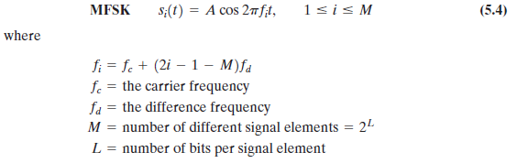
The transmitted MFSK signal for one signal element time can be defined as follows:

Slide 44

MFSK signal:
Period of the signal element
  One signal element, which is a constant-frequency tone, encodes L bits
Minimum frequency separation
MFSK signal bandwidth:

Slide 45
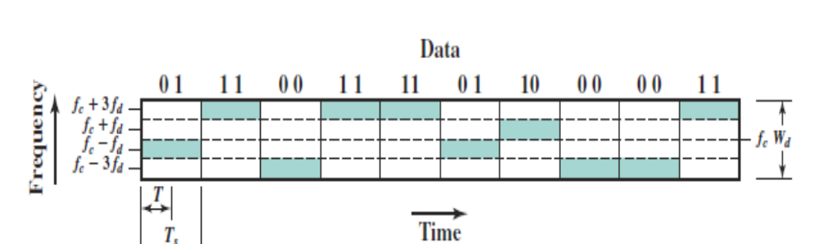

Slide 46
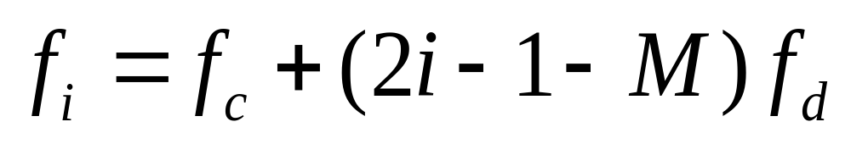
Example
With f_{c}=250KHz, f_{d}=25KHz, and M=8 (L=3 bits), we have the following frequency assignment for each of the 8 possible 3-bit data combinations:

Slide 47
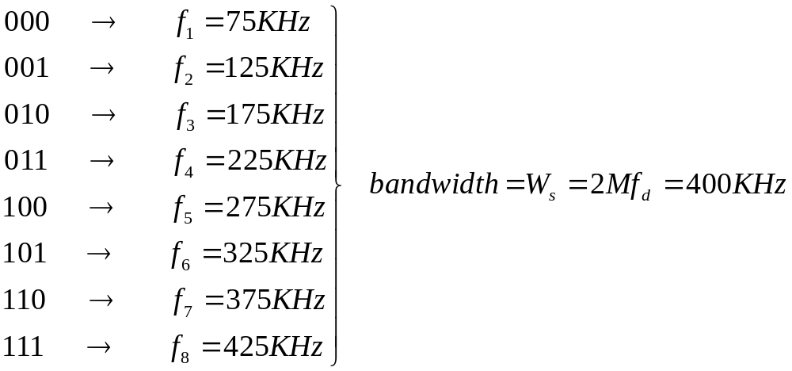
This scheme can support a data rate of:

Slide 48
Example
We need to send data 3 bits at a time at a bit rate of 3 Mbps. The carrier frequency is 10 MHz. Calculate the number of levels (different frequencies), the baud rate, and the bandwidth.

Slide 49
We can have L=3,M = 2³ = 8.
The baud rate is D=R/L
D= 3 Mbps/3 = 1 Mbaud.
The bandwidth is :
T=Bit period=1/3 micro sec
TS=LT=3*(1/3) =1 micro sec
2fd=1/TS =1MHz
Bandwidth=8MHz

Slide 50


Slide 51
Phase Shift Keying
Phase of the carrier is varied to represent digital data (binary 0 or 1)
Amplitude and frequency remains constant.
If phase 0 deg to represent 0, 180 deg to represent 1. (2-PSK)
PSK is not susceptible to noise degradation that affects ASK or bandwidth limitations of FSK

Slide 52

Two level PSK

Slide 53
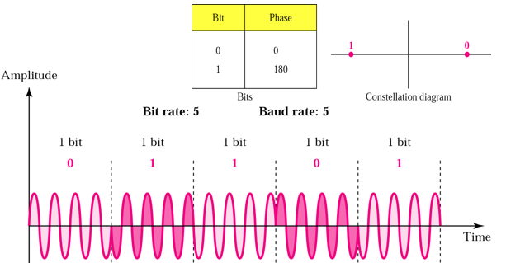

Slide 54
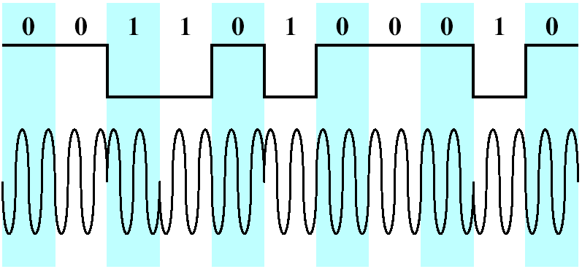
Differential PSK (DPSK)
In DPSK, the phase shift is with reference to the previous bit transmitted rather than to some constant reference signal
Binary 0:signal burst with the same phase as the previous one
Binary 1:signal burst of opposite phase to the preceding one

Slide 55
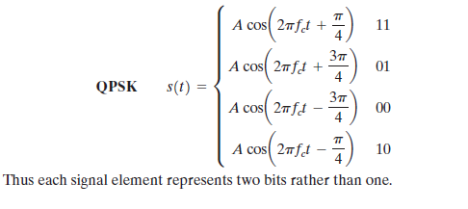
4-PSK (Quadrature PSK) method
Instead of a phase shift of 180°, as allowed in BPSK, a common encoding technique, known as quadrature phase shift keying (QPSK), uses phase shifts separated by multiples of
Most efficient use of bandwidth.

Slide 56
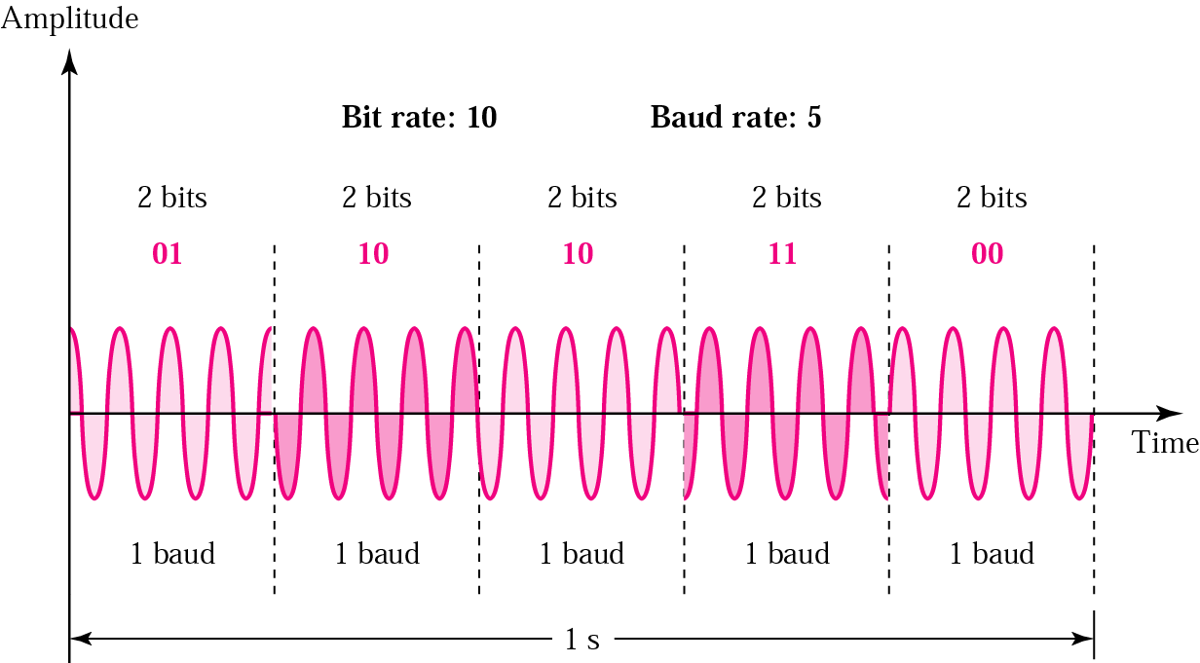
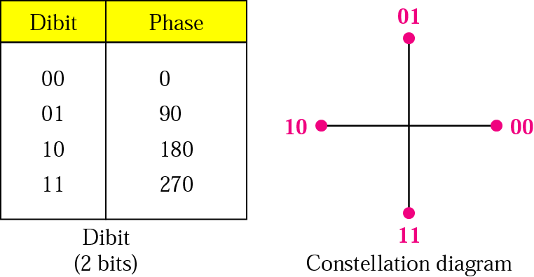

Slide 57
Quadrature PSK
To increase the bit rate, we can code 2 or more bits onto one signal element.
In QPSK, we parallelize the bit stream so that every two incoming bits are split up and PSK a carrier frequency. One carrier frequency is phase shifted 90º from the other - in quadrature.
The two PSKed signals are then added to produce one of 4 signal elements. L = 4

Slide 58
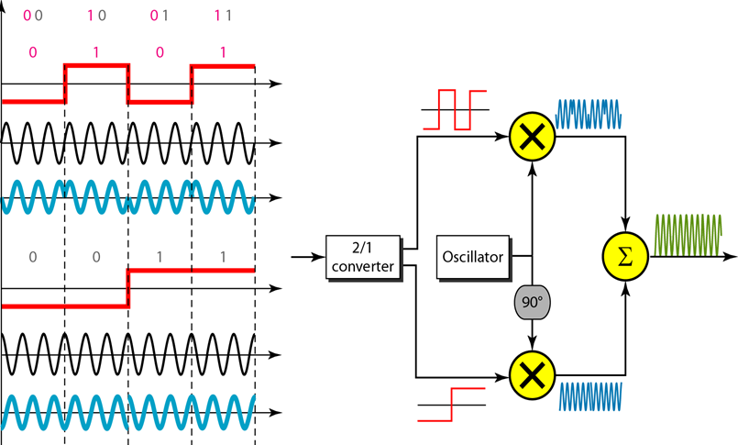

Slide 59
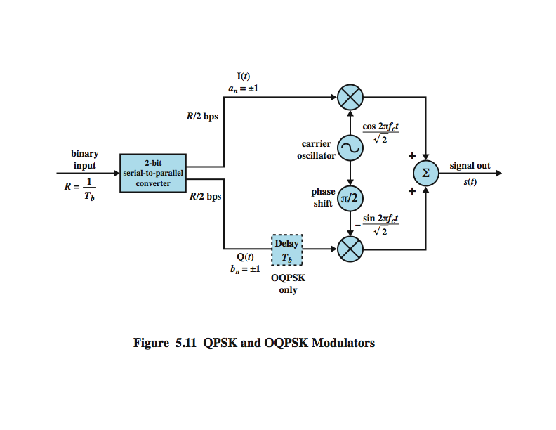
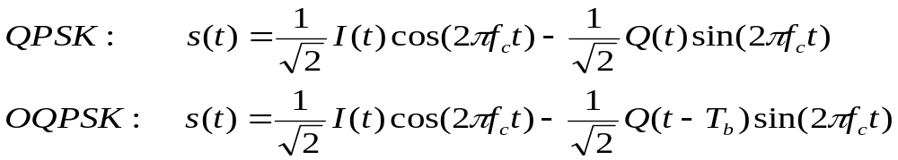
QPSK and Offset QPSK (OQPSK) Modulators

Slide 60
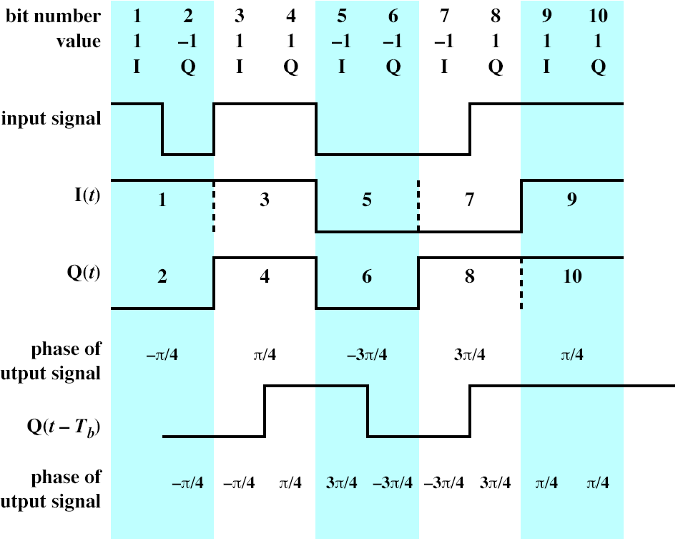
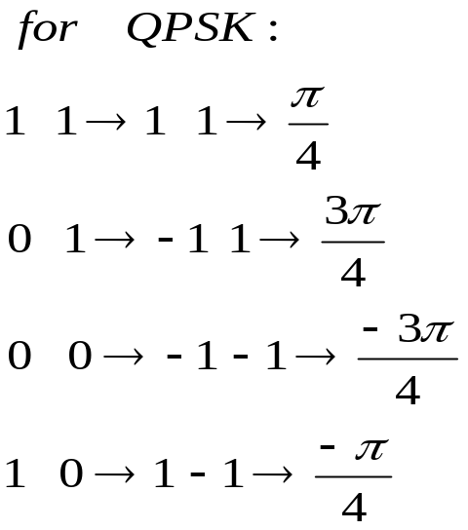

Slide 61
Performance
Transmission bandwidth BT for ASK, PSK and FSK is of the form
  BT =(1+r)R
  R- Bit rate
  r- Related to technique typically 0<r<1

Slide 62



Bandwidth Efficiency
  ASK/PSK:
  MPSK:
  MFSK:

Slide 63
Example
Find the baud rate and bandwidth for a signal transmitting at 12 Mbps, The value of r = 0.
(for QPSK )

Slide 64
The baud rate is D=R/L
L=2, R=12Mbps, r=0
D=6Mbps
For QPSK, 2 bits is carried by one signal element R=R/2=6Mbps
BT=(1+r)R=6MHZ

Slide 65
Example
We have an available bandwidth of 100 kHz which spans from 200 to 300 kHz. What should be the carrier frequency and the bit rate if we modulated our data by using FSK with r = 1?

Slide 66
The midpoint of the band is at 250 kHz. B=100KHz, r=1
  BT=(1+r)R
  100=2R
  R=100/2=50kbps

Slide 67
Example
We have an available bandwidth of 100 kHz which spans from 200 to 300 kHz. What are the carrier frequency and the bit rate if we modulated our data by using ASK with r= 1?
  BT=(1+r)R

Slide 68
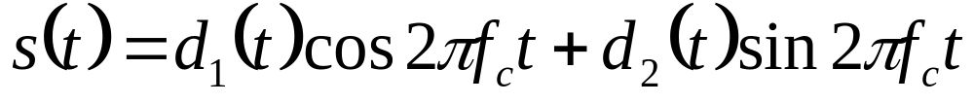
Quadrature Amplitude Modulation (QAM)
QAM used on asymmetric digital subscriber line (ADSL) and some wireless standards
combination of ASK and PSK
logical extension of QPSK
send two different signals simultaneously on same carrier frequency
  use two copies of carrier, one shifted by 90°
  each carrier is ASK modulated

Slide 69
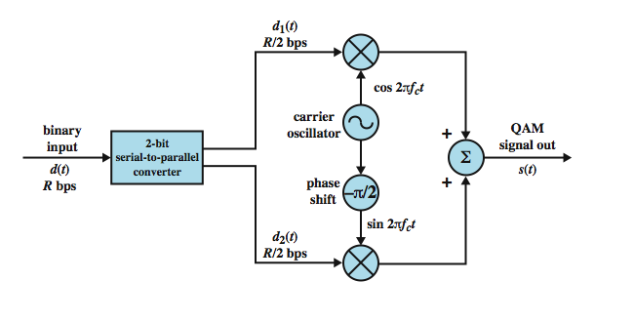
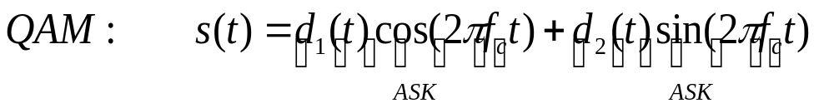
QAM modulator

Slide 70
QAM Variants
Two level ASK (two different amplitude levels)
  each of two streams in one of two states
  four state system
  essentially QPSK
Four level ASK (four different amplitude levels)
  combined stream in one of 16 states
Have 64 and 256 state systems
Improved data rate for given bandwidth
  but increased potential error rate

Slide 71
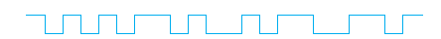
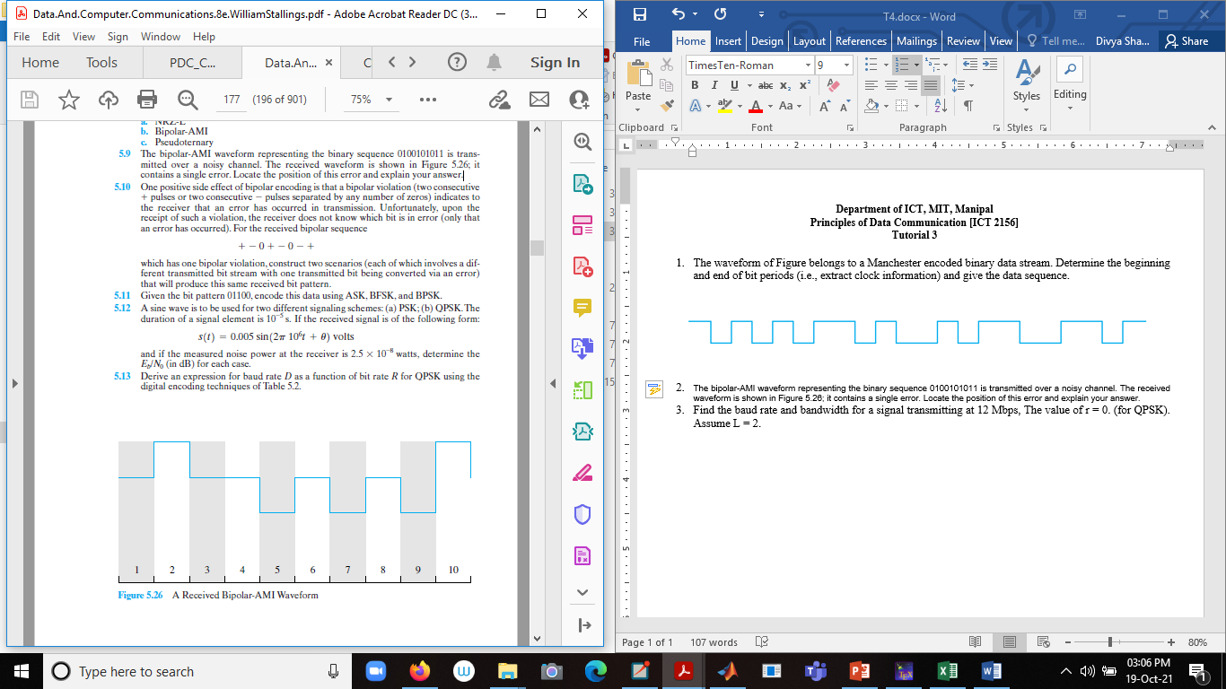
Tutorial
1. The waveform of Figure belongs to a Manchester encoded binary data stream. Determine the beginning and end of bit periods (i.e., extract clock information) and give the data sequence.
2. The bipolar-AMI waveform representing the binary sequence 0100101011 is
transmitted over a noisy channel. The received waveform is shown in Figure it contains a single error. Locate the position of this error and explain your answer.

Slide 72
3. One positive side effect of bipolar encoding is that a bipolar violation (two consecutive + pulses or two consecutive - pulses separated by any number of zeros) indicates to the receiver that an error has occurred in transmission. Unfortunately, upon the receipt of such a violation, the receiver does not know which bit is in error (only that an error has occurred). For the received bipolar sequence + - 0 + - 0 - + which has one bipolar violation, construct two scenarios (each of which involves a different transmitted bit stream with one transmitted bit being converted via an error) that will produce this same received bit pattern.
4. Assume that a telephone line channel is equalized to allow bandpass data transmission over a frequency range of 600 to 3000 Hz. The available bandwidth is 2400 Hz. For r=1, evaluate the required bandwidth for 2400 bps QPSK and 4800-bps, eight level multilevel signaling. Is the bandwidth adequate?
5. Find the baud rate and bandwidth for a signal transmitting at 12 Mbps, The value of r = 0. (for QPSK). Assume L = 2.

Slide 73
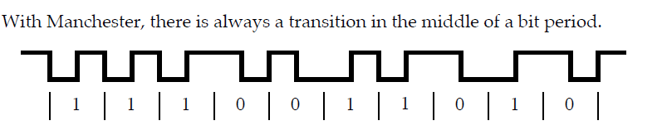
1.

Slide 74
2. The error is at bit position 7, where there is a negative pulse. For AMI, positive and negative pulses are used alternately for binary 1. The pulse in position 1 represents the third binary 1 in the data stream and should have a positive value.

Slide 75


Slide 76

4.

Slide 77


Slide 78
5.

